Slide 1

School of Science and Technology
Master’s Degree in Computer Science (LM-18)
Stats on Unicam ESSE3
Students:
Matteo Molteni 115550 Mattia Romagnoli 115934
Tommaso Cippitelli 115546
Vittorio Rinaldi 115557
Professor:
Prof. Massimo Callisto De Donato

Slide 2

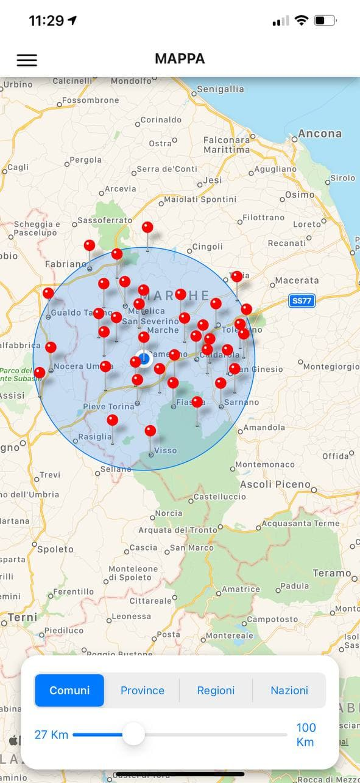
PROJECT DESCRIPTION
GOAL → Perform data analysis on Unicam ESSE3 dataset.
DESCRIPTION → Execute geo-queries based on students enrolled on Unicam.
Display students on a map: aggregated by city, province, region or Country of origin.
Get other statistical information about them in a simple and intuitive way.

Slide 3
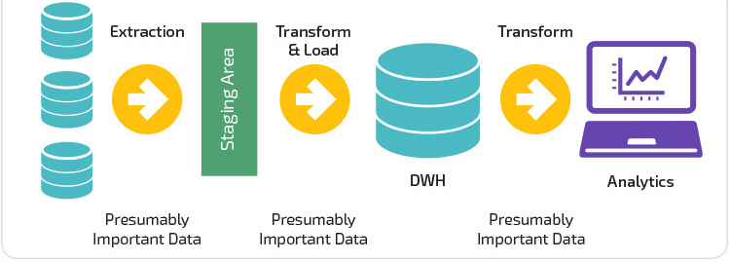
METHODOLOGIES USED
Extract content from datasource.
Transformation phase to adapt the content to the data warehouse conditions, filtering and adding the information needed.
Load the data to an external online cluster.
Manipulating the data via geo-queries.
Display results via a map and more specifically with charts and diagrams

Slide 4


BACKEND TECHNOLOGIES
Python as main programming language
Pandas to manipulate the datasource in excel
GeoPy to extrapolate the coordinates from every geographic target in the datasource
Flask to build restful API (controller)

Slide 5


DATA WAREHOUSE TECHNOLOGIES
MongoDB Atlas cloud db to store information in an online shared way
Pymongo to execute queries

Slide 6

FRONTEND TECHNOLOGIES
React native framework
Expo development platform
Axios library for http requests
React-native-maps library for the map
Victory-native library for charts and diagrams

Slide 7


DEVELOPMENT TOOLS
Docker to build/run/deploy in safe container
Github for project management
Heroku to make the server accessible to all group members
Android studio as simulator
Xcode as simulator

Slide 8

HOW TO START?
https://github.com/Matteoo98/Unicam-analytics/blob/main/README.md

Slide 9
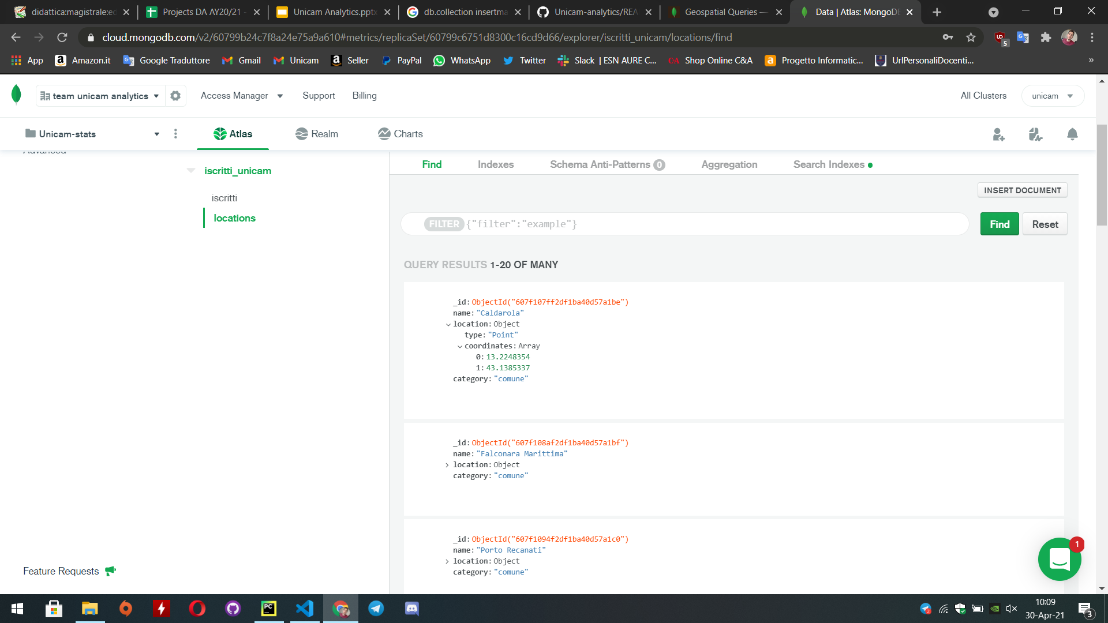
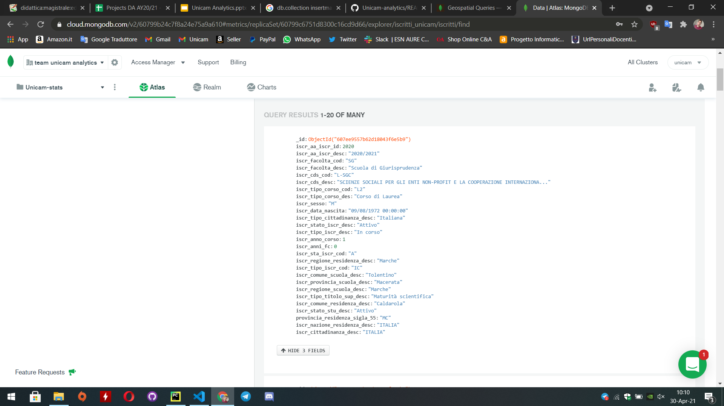
TECHNICAL IMPLEMENTATION
BACKEND
1st problem → datasource format incompatible with the pyMongo geo-query
(we missed coordinates for the geoJSON format)
solutions → data pre-processing: select distinct name of the student address
(and drop the NaN cells with Pandas);
calculate coordinates by geoPy library for each city, province, region, Country.
→ data storing: store in the online database 2 collections:
one regarding the original datasource... the second regarding coordinates.

Slide 10
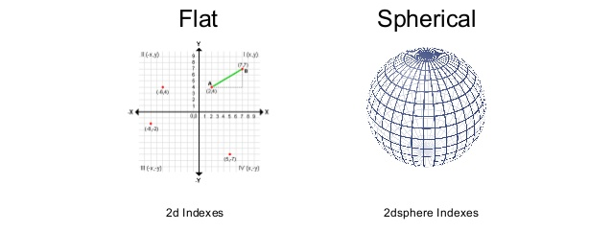
TECHNICAL IMPLEMENTATION
GeoQueries by 2dsphere Index
We created 2dsphere index because supports queries that can calculate geometries like on an earth-like sphere.
collection.create_index([("location", "2dsphere")])
Moreover supports all MongoDB geospatial queries and converts the data to GeoJSON in an efficient way.

Slide 11
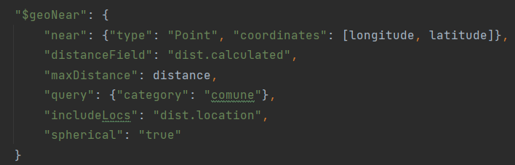
TECHNICAL IMPLEMENTATION
2nd problem → to make deeper data analysis, we need a way to merge our 2 collections stored in the db.
solution → pyMongo query:
1) “geoNear” to return documents in order of nearest to farthest from a specified point given a range of distance

Slide 12
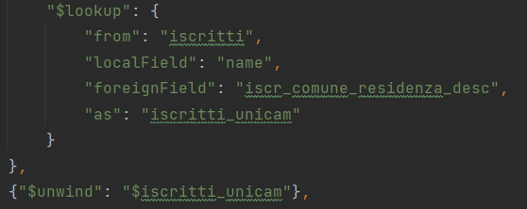
TECHNICAL IMPLEMENTATION
2) “lookup” to performs a left outer join with the other collection
3) “unwind” to deconstructs the join object

Slide 13
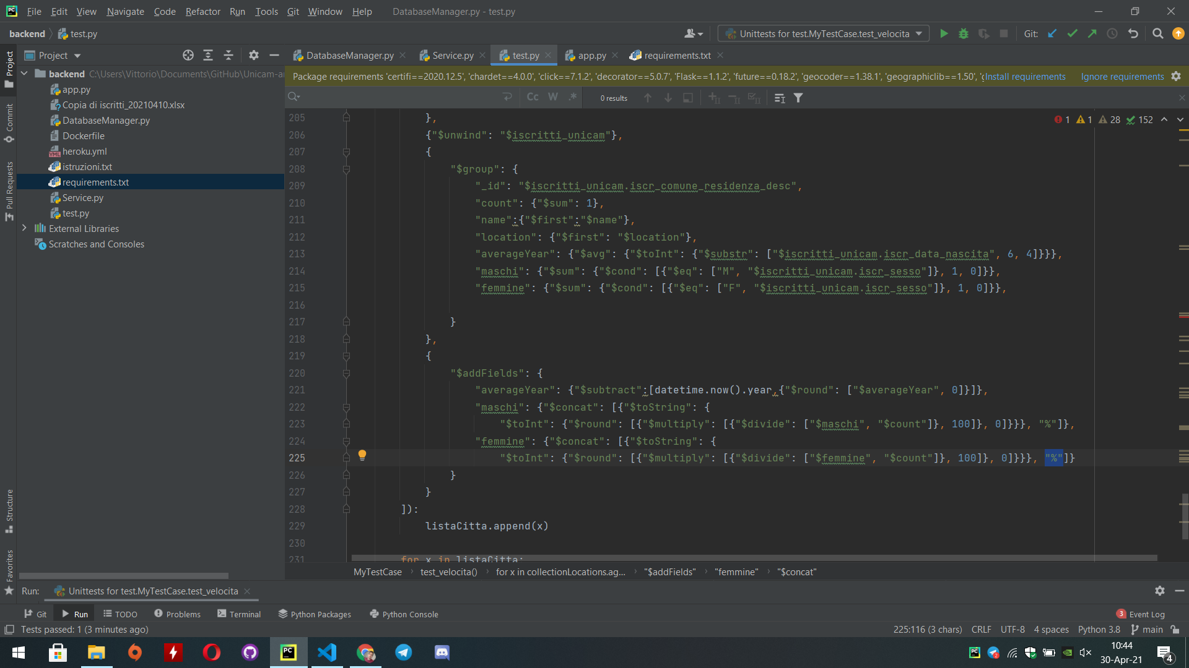
TECHNICAL IMPLEMENTATION
4) “group” by city to performs data analysis on students
5) “addFields” to adapt data to our needs

Slide 14
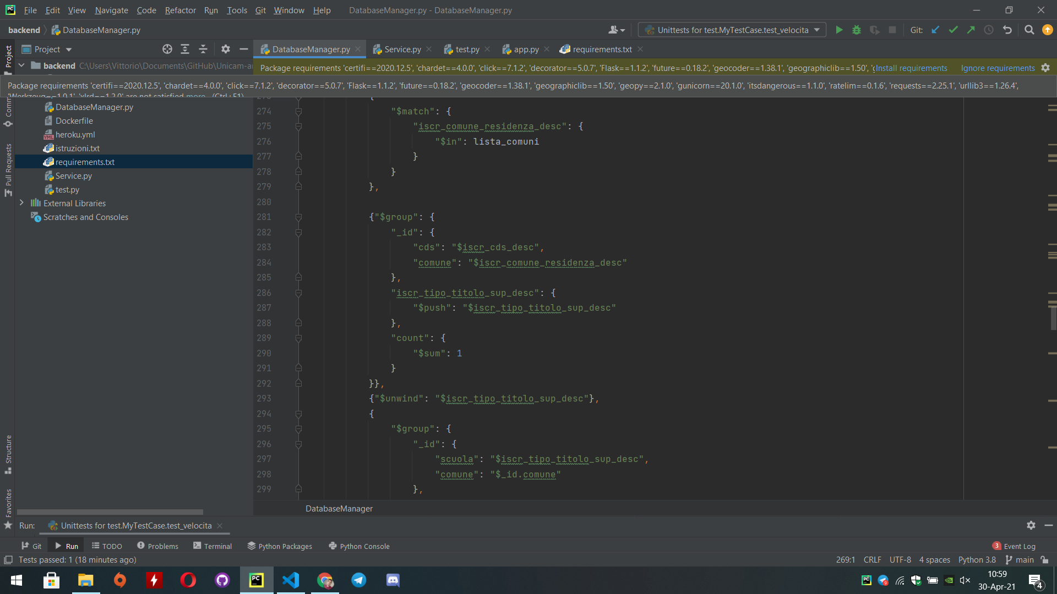
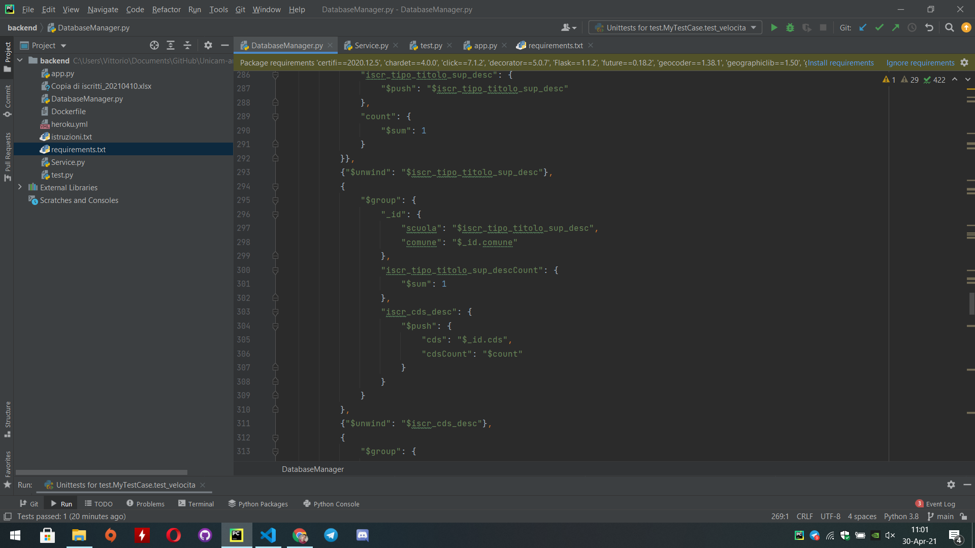
TECHNICAL IMPLEMENTATION
3rd problem → collect for each city more detailed info concerning the field of study and high school diploma of living students
solution: pyMongo query →
1) “match” to select all the students from the city of interest
2) “group” to perform data analysis on field of study and high school diploma of the students

Slide 15
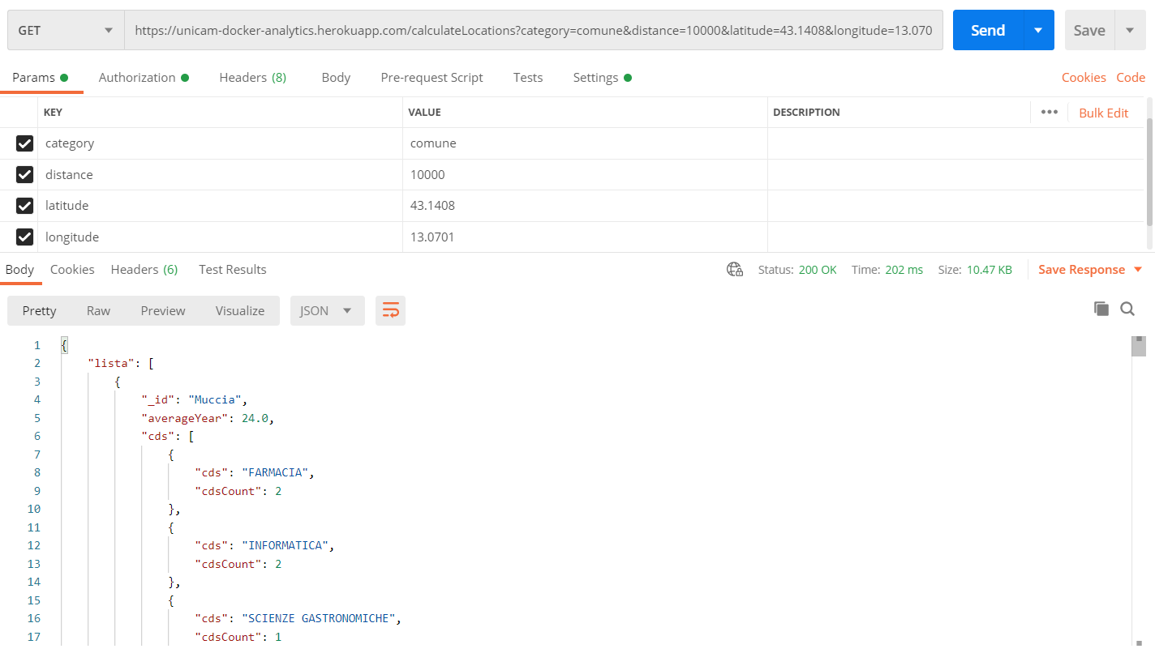
TECHNICAL IMPLEMENTATION
final step → GET request to our server
The request is composed by 4 parameters:
Category
Distance
Latitude
Longitude
URL: https://unicam-docker-analytics.herokuapp.com/calculateLocations

Slide 16
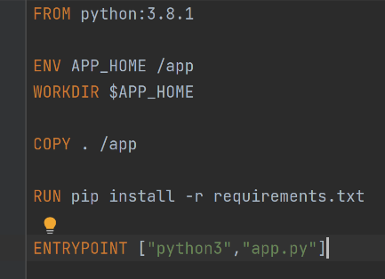
TECHNICAL IMPLEMENTATION
Allows us to build our required image over a base image
Set the current working directory
Copies the content of the folder to the container
Install all the packages needed
Run the application

Slide 17
TECHNICAL IMPLEMENTATION
To make the server accessible to the group components, we dockerized our Flask application.
docker build -t <your username>/flask-docker . docker run -p 5000:5000 <your username>/flask-docker
Then, we deployed the Application to Heroku, a container-based cloud Platform as a Service giving us the freedom to focus on our core product without the distraction of maintaining servers, hardware

Slide 18
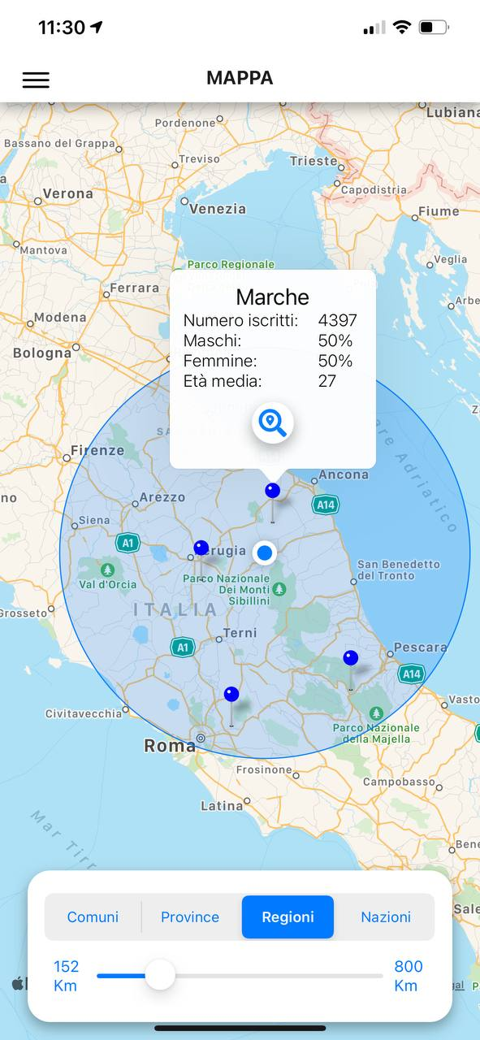
ACHIEVED RESULTS
The user is able to see the spread of the students along the territory, using a radius starting from his position
Choosing the conditions

Slide 19
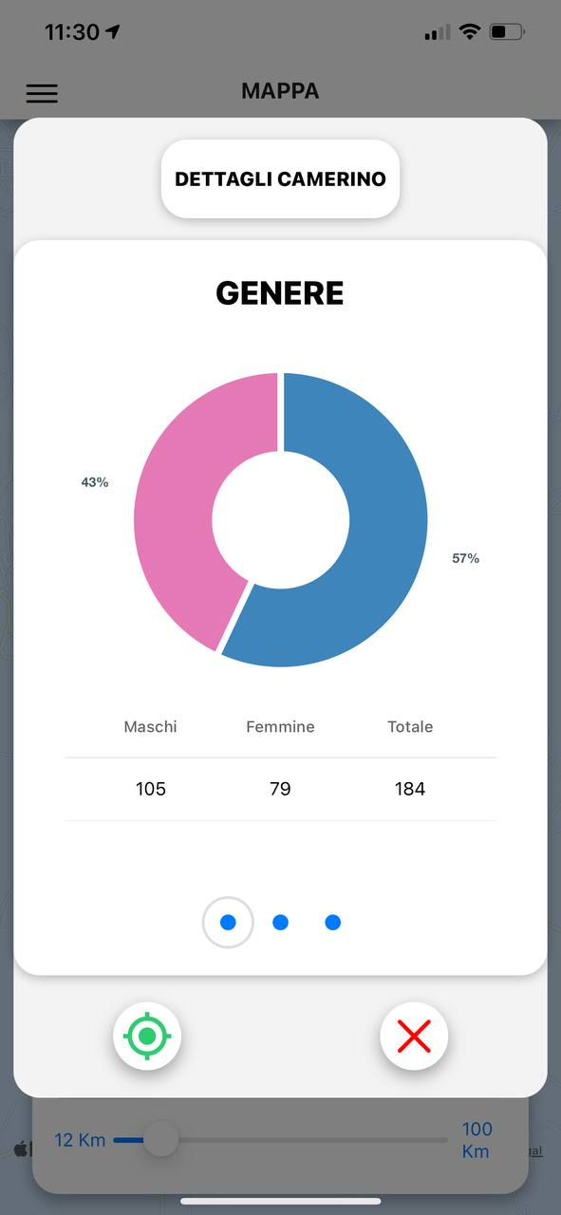
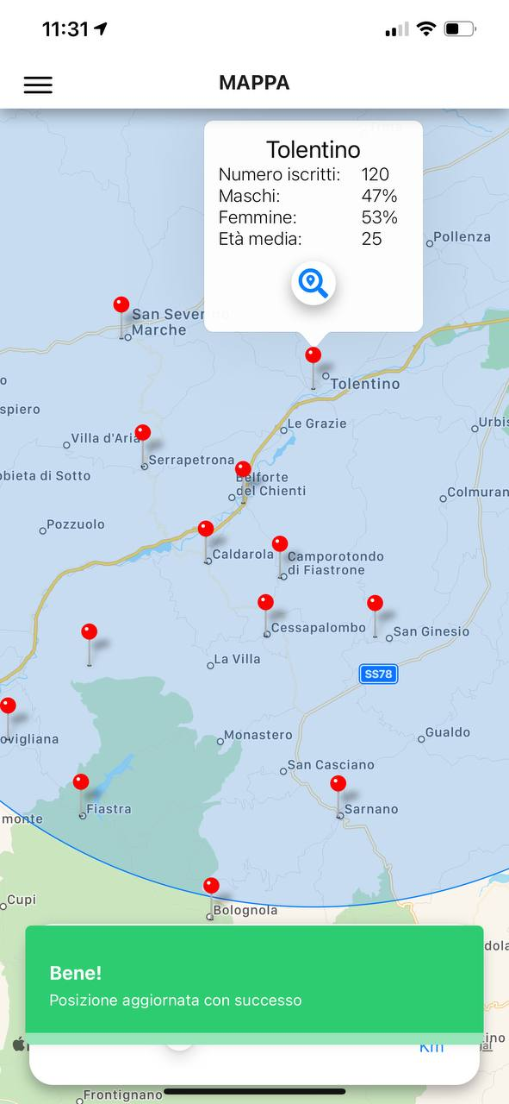
ACHIEVED RESULTS
Observing different data for each marker,
like gender stats...
Change the user position to the relative marker

Slide 20
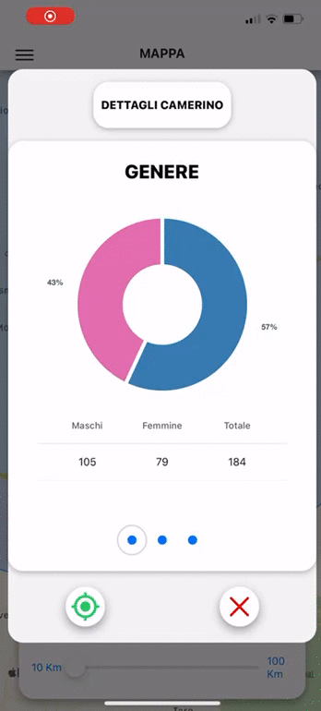
ACHIEVED RESULTS
Swiping with a finger from gender stats to courses stats, to conclude with high school path of the students in that marker

Slide 21
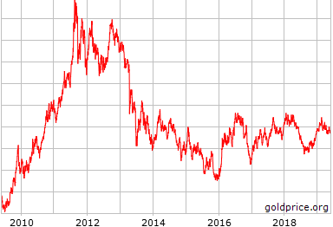
FUTURE IMPROVEMENTS
Get historical data for along years
Trends
Previsions (Machine learning)

Slide 22


FUTURE IMPROVEMENTS
Google API for apk deployment
Add this project to the real Dashboard of the University
More sophisticated UI

Slide 23
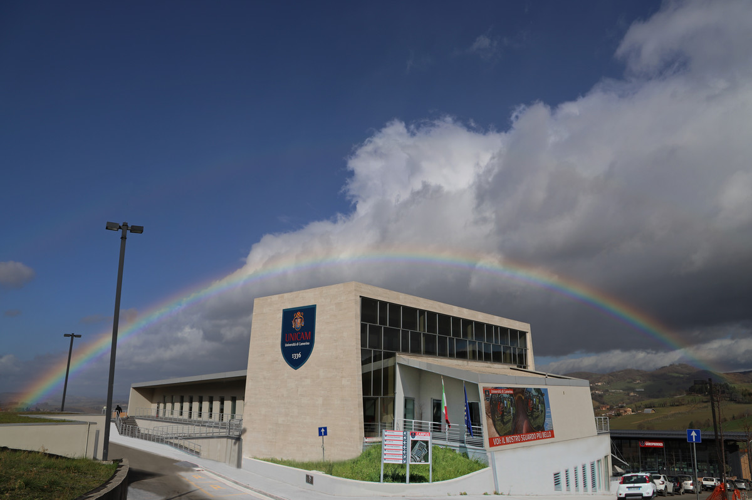
ACKNOWLEDGEMENT
Prof. Gagliardi for giving us a filtered datasource for the analysis
Prof. Callisto De Donato for the opportunity to learn new technologies and concepts

Slide 24
THANKS FOR THE ATTENTION

